Slide 2
Building a Better World
One Idea at a Time
Xavier School Innovation Camp
Club Collaboration Project

Slide 3
The Best Backpack Challenge
Xavier School Innovation Camp
Club Collaboration Project

Slide 4
Design your ideal backpack! Now! Use the worksheet!
Xavier School Innovation Camp
Club Collaboration Project

Slide 5
Oops!That was Problem-Solving approach!
Xavier School Innovation Camp
Club Collaboration Project

Slide 6
Now, we do design-thinking approach!
Xavier School Innovation Camp
Club Collaboration Project

Slide 7
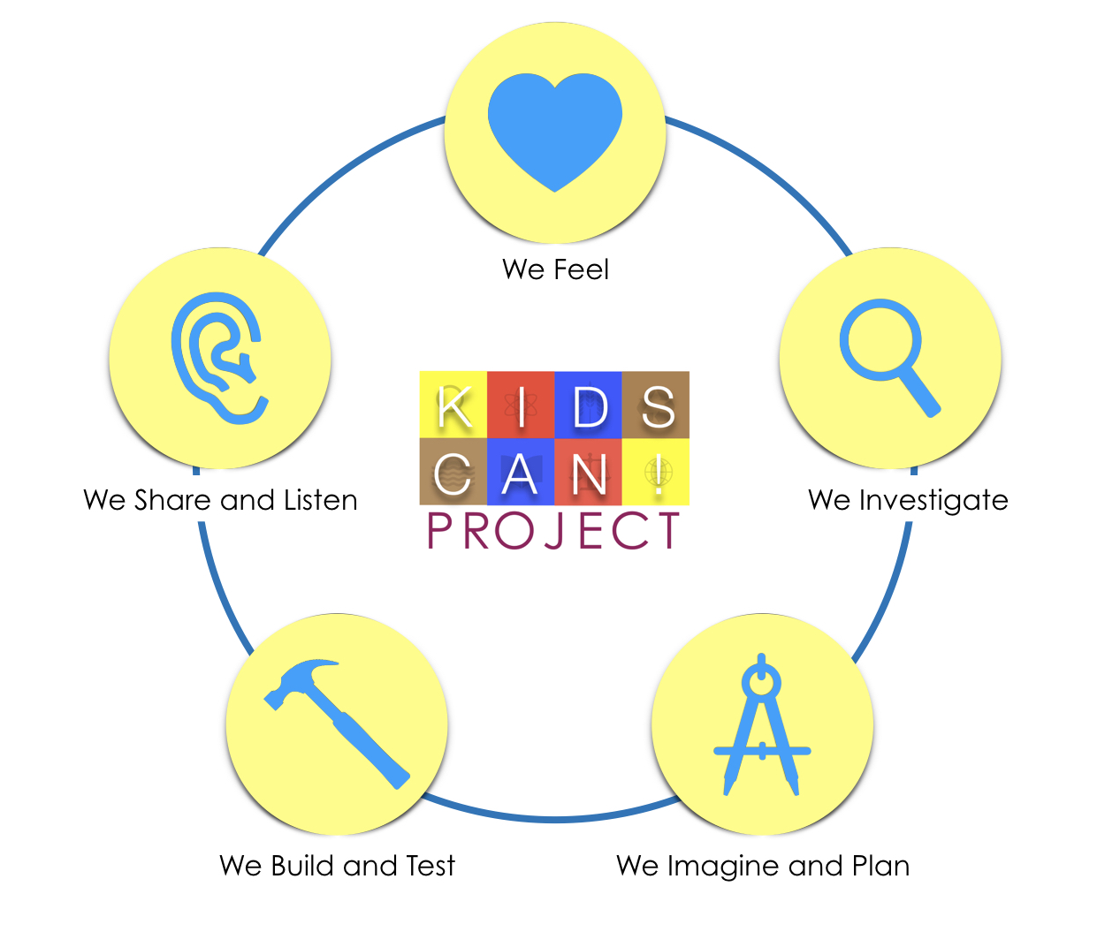
Notes:
Explain the five stages:
We Feel
Students are given time to empathize or feel for someone who may have or facing some problems. They look at the needs and concerns of the person whom they are empathizing with, as well as, the social or personal situations they are in.
We Investigate
Students dig deeper into the problem that they have identified. They clearly identify the problem and its root, the conditions, and consequences that go with it. They start to ask: “How can we…”
We Imagine and Plan
Students lay their plan on how to solve or provide a solution to the problem. They identify as many solutions as they can. In the end, they need to choose the “best” solution according to feasibility, effectivity, and efficiency.
We Build and Test
Students build and create the prototype of the solution. They can be as resourceful and creative in building their prototype. Students can let others use and test their prototype. They further evaluate and work on improving their prototype based on the feedback from the first users or testers.
We Share and Listen
Students are ready to bring their solution out in the public. They share their product and the story behind it. They listen to the feedback and comments of other people to further improve their solution.

Slide 8
OUR JOB: Design something USEFUL & MEANINGFUL for your client.
Xavier School Innovation Camp
Club Collaboration Project

Slide 9
Step 1: We Feel
“empathy”
Directions:
Interview your client.
Guide questions are in the empathy worksheet.
Take note of your client’s answers through writing on the worksheet.
Interview Time: 5 minutes
Xavier School Innovation Camp
Club Collaboration Project
Notes:
Explain what empathy means and how they can show empathy to their clients.
We Feel Worksheet/ empathy map will be done after this.

Slide 10
Step 2: We Investigate
“digging deeper about the problem”
Make the problem clear and research about it.
DEFINE your client’s need by writing a NEEDS STATEMENT
Follow this statement format: _____(Name)_____
needs ________________ because ______________________.
Xavier School Innovation Camp
Club Collaboration Project
Notes:
Explain what empathy means and how they can show empathy to their clients.
We Feel Worksheet/ empathy map will be done after this.

Slide 11
Step 3: We Imagine and Plan
Directions:
Do the Ideate Worksheet. Come up with a lot of ideas.
Then, meet as a group and compare solutions.
Choose the “best” solution according to the following criteria:
feasibility - Is the solution “do-able” or capable of being accomplished?
effectivity - Is the solution effective enough to address and solve the problem?
efficiency - Is the solution something that can be done with less effort, money, or materials?
Xavier School Innovation Camp
Club Collaboration Project
Notes:
Explain what empathy means and how they can show empathy to their clients.
We Feel Worksheet/ empathy map will be done after this.

Slide 12
Step 4: We Build and Test
Building time! Prototype and test and test!
Xavier School Innovation Camp
Club Collaboration Project
Notes:
Explain what empathy means and how they can show empathy to their clients.
We Feel Worksheet/ empathy map will be done after this.

Slide 13
Step 5: We Share and Listen
Share your product and the story behind it. Listen to the feedback and comments of other people to further improve your solution.
Xavier School Innovation Camp
Club Collaboration Project
Notes:
Explain what empathy means and how they can show empathy to their clients.
We Feel Worksheet/ empathy map will be done after this.

Slide 14
Mindfulness
Was your initial design the same or different than your final design?
Where did you get stuck?
When did you get your best idea? Describe the moment.
How well did you capture your partners’ needs?
Xavier School Innovation Camp
Club Collaboration Project
Notes:
Explain what empathy means and how they can show empathy to their clients.
We Feel Worksheet/ empathy map will be done after this.

Slide 15
Reference:
A Taste of Design Thinking: Redesigning the Backpack
Backpack icon - ShareIcon
Xavier School Innovation Camp
Club Collaboration Project

